Slide 1
CNN Features off-the-shelf: an Astounding Baseline for Recognition
Ali Sharif Razavian Hossein Azizpour Josephine Sullivan Stefan Carlsson
1.皇家理工学院计算机科学与通信实验室，PhD. Student，His research interest is Computer Vision and Machine Learning.
2.3皇家理工学院计算机科学与通信实验室，Ph.D. student，Under the supervision of Prof. Stefan Carlsson.
Their research interest iscomputer vision
4.皇家理工学院计算机科学与通信实验室 , professor, His research interest includes learning in connection with object, scene and action recognition as well as 3D visualization of human motion.

Slide 2
overview：
General idea
Introduction
Visual Classification
Visual Instance Retrieval
Conclusion
Image Classification
Object Detection
Fine grained Recognition
Attribute Detection
Implementation Details

Slide 3
General idea：
Argument from CNN training model, extract the feature of powerful functions
1.By image classification, scene recognition, fine grained recognition, attribute detection and image retrieval evidence it.
2.In the experiments, different training and testing data sets, using the average precision rate to evaluate the results
3.Report consistent superior results compared to the highly tuned state-of-the-art systems in all the visual classification tasks on various datasets.

Slide 4
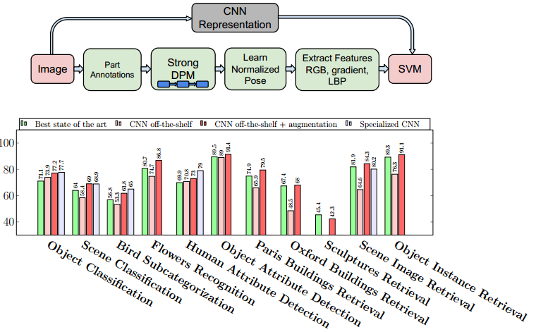
Introduction：

Slide 5
CNN way to extract characteristics compared with other algorithm to extract features of advantage
1)time
2)programming skills
3)amount of labelled data
4)average precision

Slide 6
By discussing the ways of communicating, the current CNN problem in computer vision.
The main problem and the conclusion is as follows
1)CNN + linear classifier, this kind of method in image classification visual task is the most effective
2)In the fine - grained classification, using the data augmentation techniques can beats the best performing methods
3)develop any new algorithm for a recognition task then it must be compared against the strong baseline of generic deep features + simple classifier.

Slide 7
Visual Classification
Method
1)The feature vector is further L2 normalized to unit length for all the experiments.
2)Further augment the training set by adding samples(cropped and rotated )

Slide 8
Image Classification
Use two challenging recognition datasets(Very challenging)
1.Pascal VOC.
The objects are not centered and in general the appearance of objects in VOC is perceived to be more challenging than ILSVRC.
2.MIT-67 indoor scenes.
The data sets of similar image similarity is bigger

Slide 9
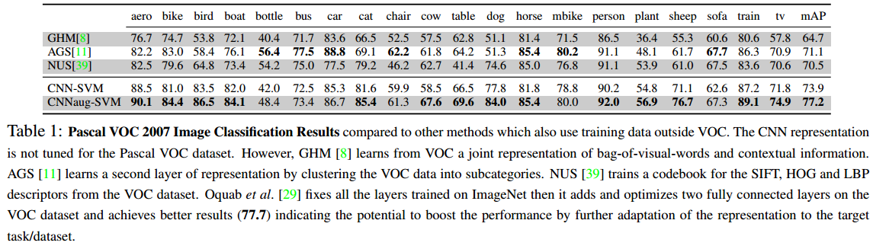
Results of PASCAL VOC Object Classification

Slide 10
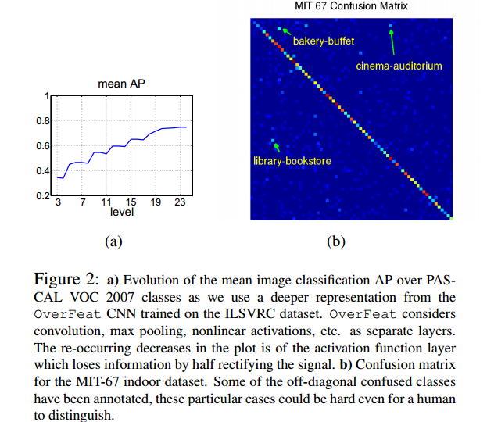
Results of MIT 67 Scene Classification

Slide 11
Object Detection
Author has not conducted any experiments for using CNN off-the-shelf features for the task of object detection
But it is worth mentioning that Girshick et al. [15] have reported remarkable numbers on PASCAL VOC 2007 using off-the-shelf features from Caffe code.

Slide 12
Fine grained Recognition
Use two challenging recognition datasets(Very challenging too)
1.Caltech-UCSD Birds (CUB) 200-2011.
Many of the species in the dataset exhibit extremely subtle differences which are sometimes even hard for humans to distinguish.
2.Oxford 102 flowers.
The flowers appear at different scales, pose and lighting conditions

Slide 13
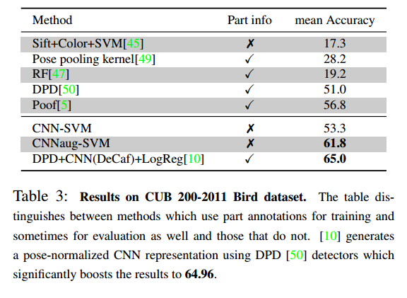
Results on CUB 200-2011 Bird dataset

Slide 14
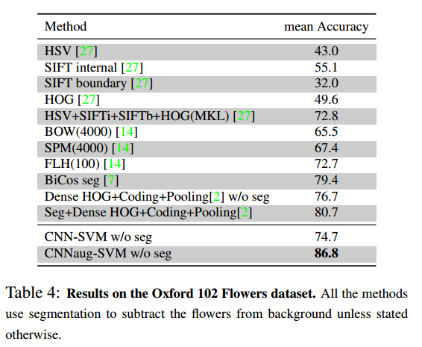
Results on the Oxford 102 Flowers dataset

